Slide 1
Principle of DevOps

Slide 2
Three ways principle
Systems thinking
Amplifying feedback loops
A culture of continuous experimentation and learning

Slide 3
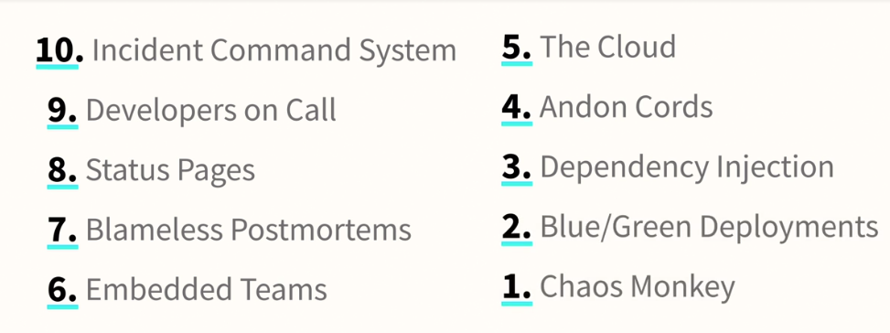

Slide 4
Version Controlling

Slide 5

What is Version Controlling?
Distributed version control
Users keep entire code and history on their location machines
Users can make any changes without internet access
(Except pushing and pulling changes from a remote server)

Slide 6
Why use Version controlling?
Easily management collaboration on a project by avoiding frustration of swapping files.
Ability to have unlimited number of developers working on the same code base.
Easily revert back your files if something happened.

Slide 7
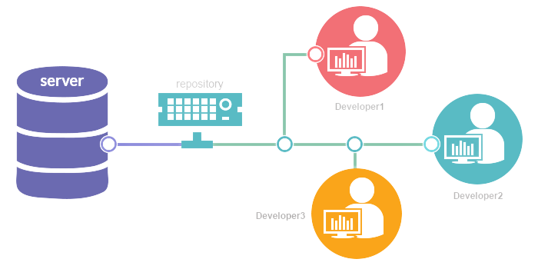

Slide 8
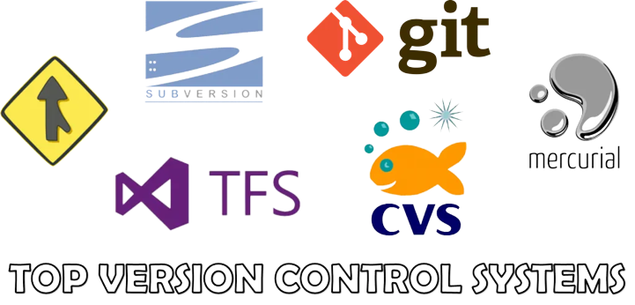

Slide 9

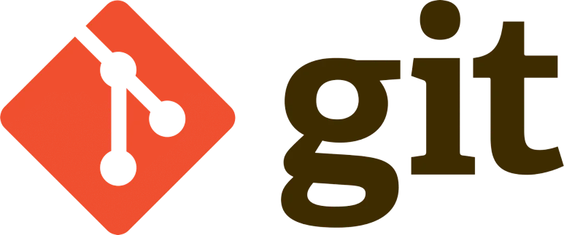

Slide 10

Hands-on Implementation

Slide 11
Any Queries?

